Slide 1
Project Scope Management
Dr. Farrukh Zeshan

Slide 2
Project Scope Management
Introduction to project scope
Plan scope management
Collect requirements
Define scope
Create WBS
Control scope
Validate scope.

Slide 3
Plan Scope Management
Scope refers to all the work involved in creating the products of the project and the processes used to create them
How the project scope will be defined, validated, and controlled. The key benefit of this process is that it provides guidance and direction on how scope will be managed throughout the project.

Slide 4
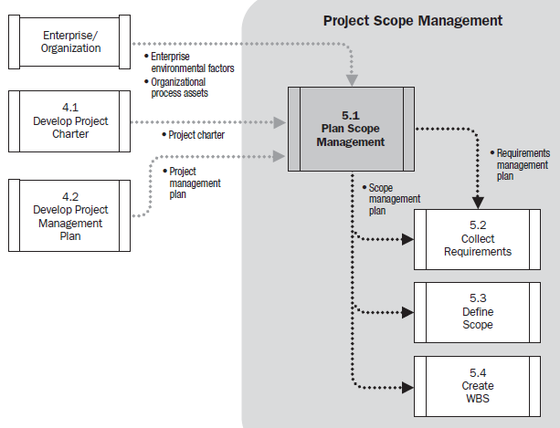
Plan Scope Management

Slide 5
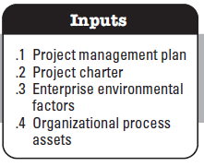
Plan Scope Management

Slide 6
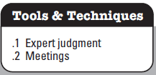
Plan Scope Management

Slide 7
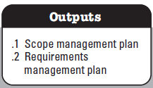
Plan Scope Management

Slide 8
Name | Role | Responsibilities
ABC | Sponsor | -Approve or deny scope change requests as appropriate -Evaluate need for scope change requests -Accept project deliverables
BCD | Project Manager | - Measure and verify project scope - Facilitate scope change requests - Facilitate impact assessments of scope change requests - Organize and facilitate scheduled change control meetings - Communicate outcomes of scope change requests - Update project documents upon approval of all scope changes
CDE | Team Lead | - Measure and verify project scope - Validate scope change requests - Participate in impact assessments of scope change requests - Communicate outcomes of scope change requests to team - Facilitate team level change review process
DEF | Team Member | - Participate in defining change resolutions - Evaluate the need for scope changes and communicate them to the project manager as necessary
EFG | Team Member | - Participate in defining change resolutions - Evaluate the need for scope changes and communicate them to the project manager as necessary

Slide 9
Collect Requirements
Collect Requirements is the process of determining, documenting, and managing stakeholder needs and requirements to meet project objectives.
The key benefit of this process is that it provides the basis for defining and managing the project scope including product scope.

Slide 10
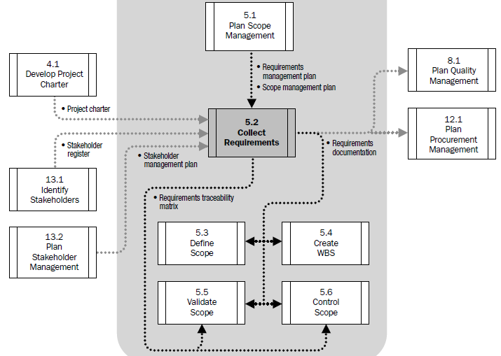
Collect Requirements

Slide 11
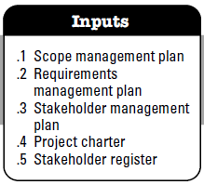
Collect Requirements

Slide 12
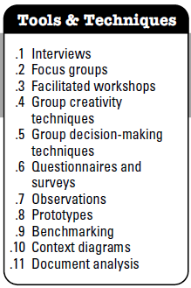
Collect Requirements

Slide 13
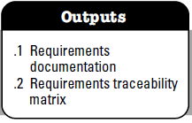
Collect Requirements

Slide 14
Student Management System
Actor | Requirement | Use Case
Student | REQ-1: System should allow to change Password | Change Password(UC-1)
Student | REQ-2: System should allow to register courses for an upcoming semester. | Course Registration (UC-2)
Student | REQ-3: System should display the tuition account details | View Account (UC-3)
Student | REQ-4: System should display the progress report | View Progress Report (UC-4)
…….. | …….. …….. …….. | ……..
…….. | …….. …….. …….. | ……..

Slide 15
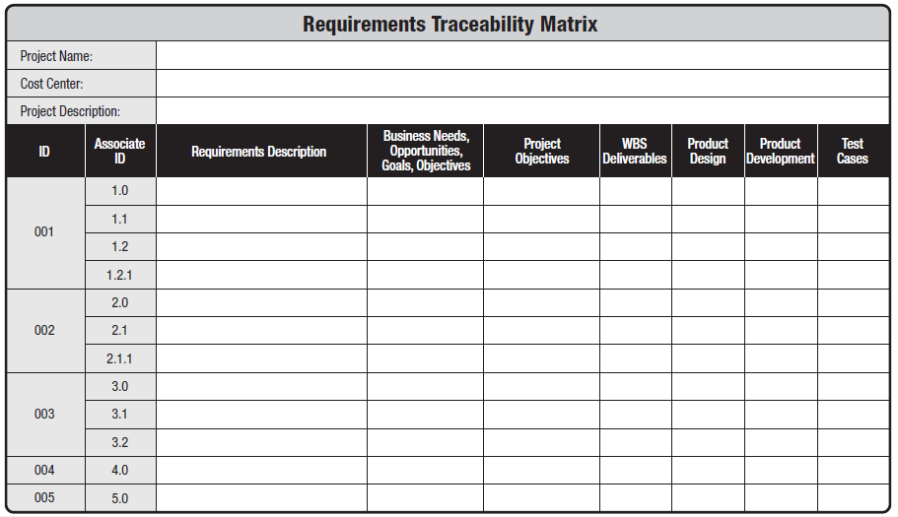
5.2 Collect Requirements
Introduction

Slide 16
5.3 Define Scope
Define Scope is the process of developing a detailed description of the project and product. The key benefit of this process is that it describes the project, service, or result boundaries by defining which of the requirements collected will be included in and excluded from the project scope.

Slide 17
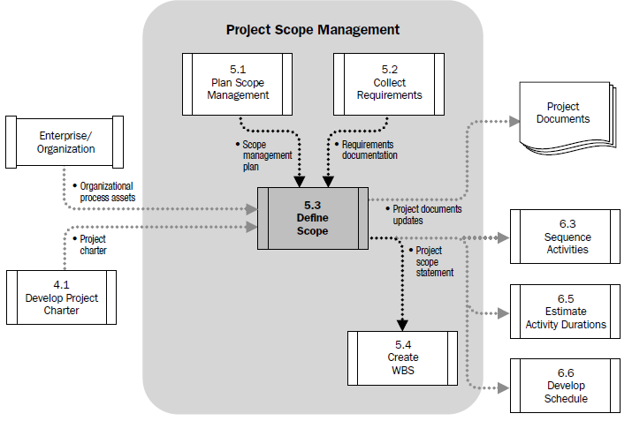
5.3 Define Scope

Slide 18
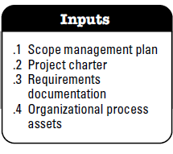
5.3 Define Scope

Slide 19
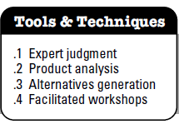
5.3 Define Scope

Slide 20
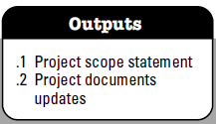
5.3 Define Scope

Slide 21
5.4 Create WBS
A WBS is a deliverable-oriented grouping of the work involved in a project that defines the total scope of the project
WBS is a foundation document that provides the basis for planning and managing project schedules, costs, resources, and changes
Decomposition is subdividing project deliverables into smaller pieces
A work package is a task at the lowest level of the WBS

Slide 22
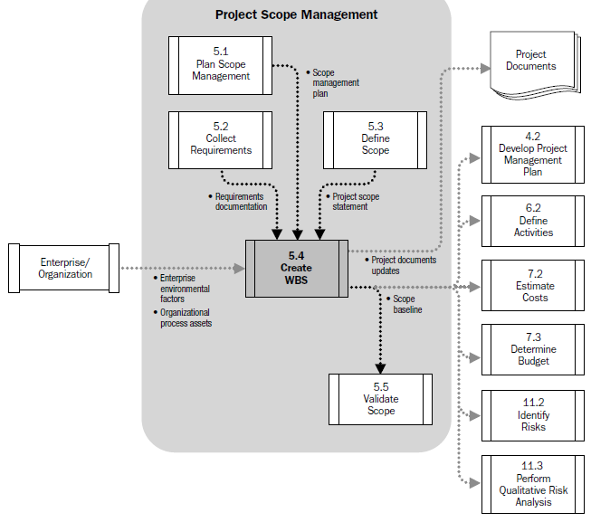
5.4 Create WBS

Slide 23
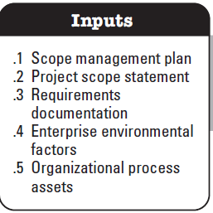
5.4 Create WBS

Slide 24
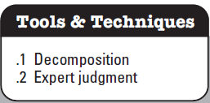
5.4 Create WBS

Slide 25
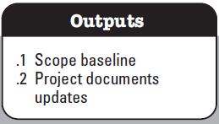
5.4 Create WBS

Slide 26
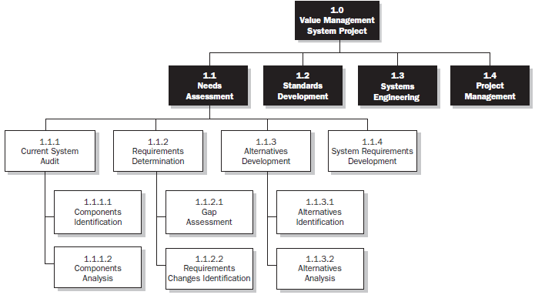
5.4 Create WBS

Slide 27
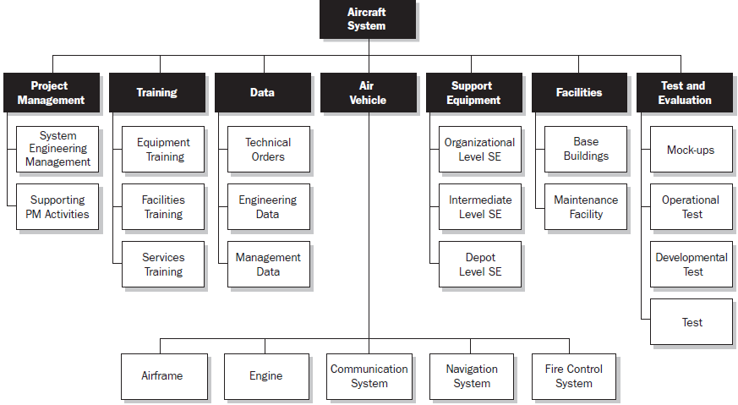
5.4 Create WBS
Introduction

Slide 28
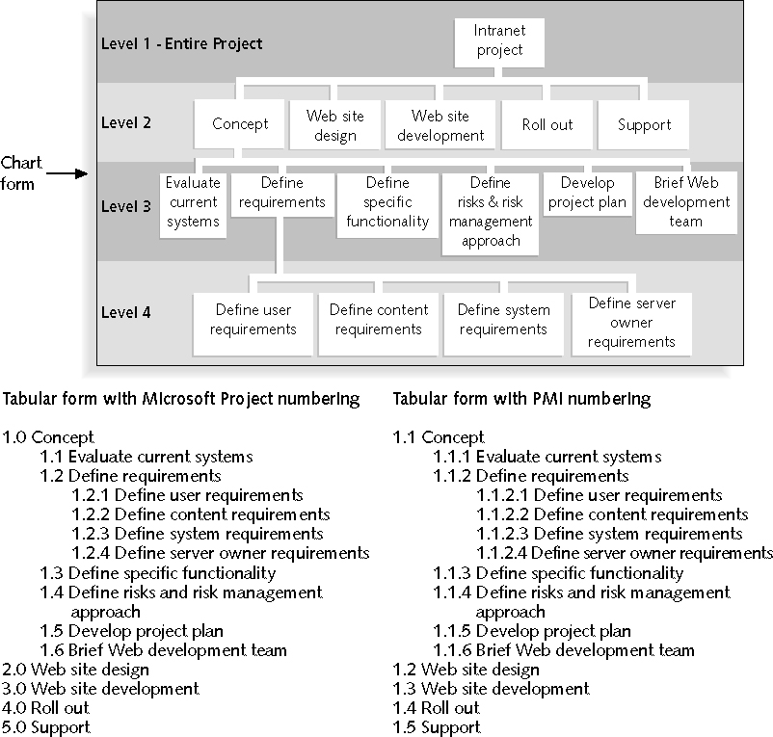

Slide 29
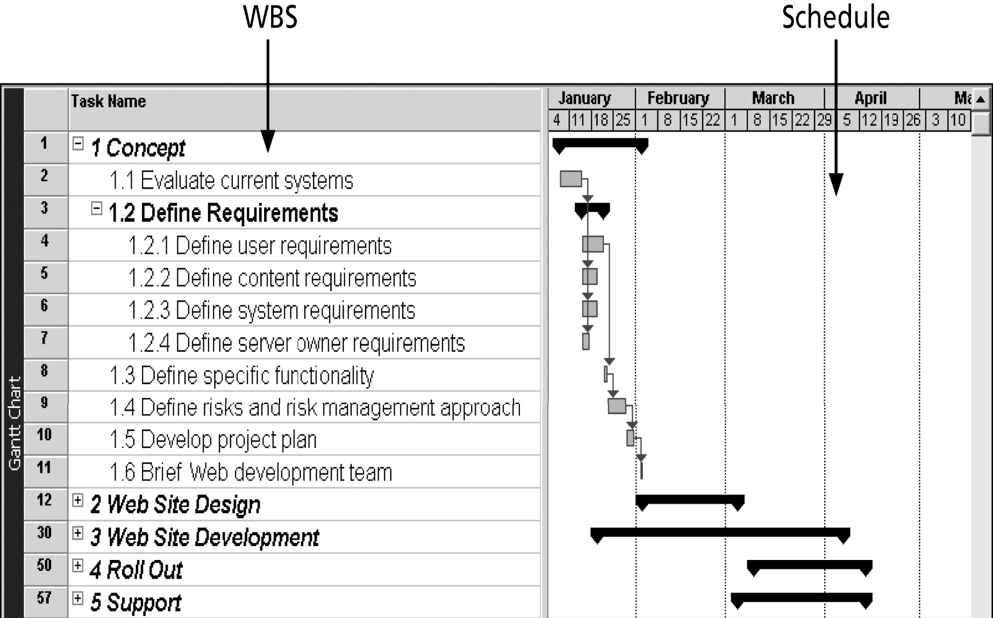
WBS and Gantt Chart in
Microsoft Project

Slide 30
5.5 Validate Scope
Scope verification involves formal acceptance of the completed project scope by the stakeholders
Acceptance is often achieved by a customer inspection and then sign-off on key deliverables

Slide 31
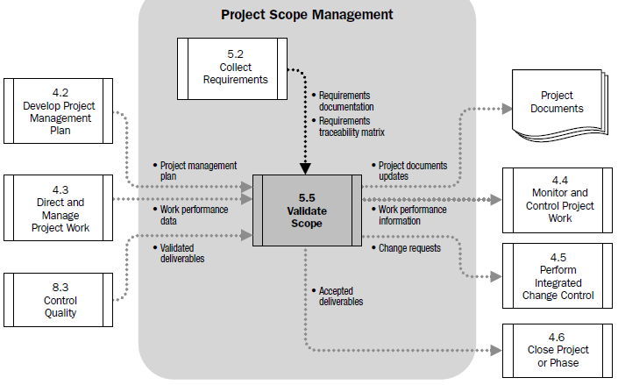
5.5 Validate Scope

Slide 32
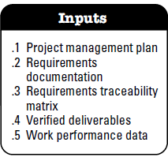
5.5 Validate Scope

Slide 33
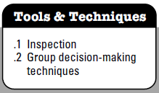
5.5 Validate Scope

Slide 34
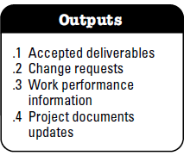
5.5 Validate Scope

Slide 35
5.6 Control Scope
Control Scope is the process of monitoring the status of the project and product scope and managing changes to the scope baseline.
Controlling the project scope ensures all requested changes and recommended corrective or preventive actions are processed through the Perform Integrated Change Control process
Control Scope is also used to manage the actual changes when they occur and is integrated with the other control processes.

Slide 36
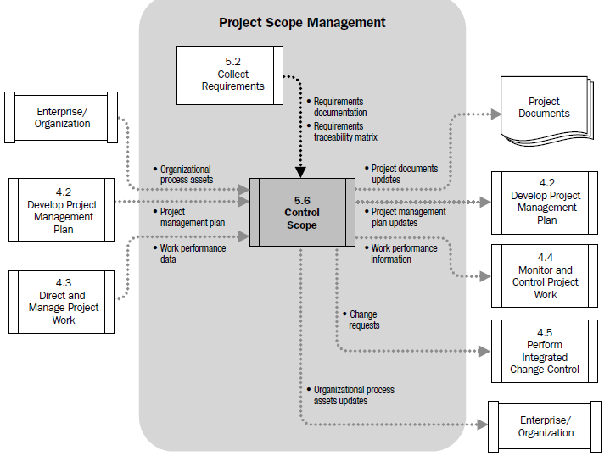
5.6 Control Scope

Slide 37
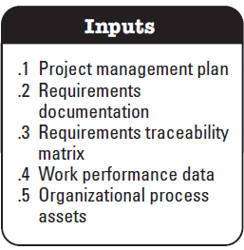
5.6 Control Scope

Slide 38
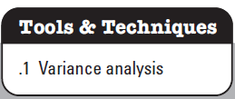
5.6 Control Scope

Slide 39
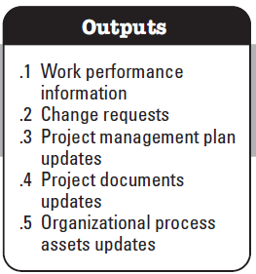
5.6 Control Scope

Slide 40
Quiz
All of the following are true about the project scope management plan EXCEPT:
  A. It provides guidance on how project scope will be defined, documented, managed, and controlled.
  B. It provides guidance on how project scope will be verified.
  C. It may be formal or informal, highly detailed, or broadly framed, based upon the needs of the project.
  D. It is separate from the project management plan.
Answer: D

Slide 41
Quiz
Collect Requirements is the process of defining and documenting stakeholders’ needs to meet the project objectives. All of the following are true about this process EXCEPT:
A. The project’s success is directly influenced by the care taken in capturing and managing project and product requirements.
B. Requirements include the quantified and documented needs and expectations of the sponsor, customer, and other stakeholders.
C. Requirements become the foundation of the WBS. Cost, schedule, and quality planning are all built upon these requirements.
D. The development of requirements begins with an analysis of the information contained in the risk register.
Answer: D

Slide 42
Quiz
All of the following are true about the project scope statement EXCEPT:
A. It is an output of the Verify Scope process.
B. It describes, in detail, the project’s deliverables and the work required to create those deliverables.
C. It provides a common understanding of the project scope among project stakeholders.
D. It may contain explicit scope exclusions that can assist in managing stakeholder expectations.
Answer: A

Slide 43
Quiz
All of the following are true about the Control Scope process EXCEPT:
A. Control Scope is the process of monitoring the status of the project and product scope and managing changes to the scope baseline.
B. Project scope control is used to manage the actual changes when they occur and is integrated with the other control processes.
C. Scope changes can be avoided by developing clear and concise specifications and enforcing strict adherence to them.
D. Scope control includes determining the cause and degree of variance relative to the scope baseline and deciding whether corrective or preventive action is required.
Answer: C

Slide 44
Quiz
Which of the following statements is true about the work breakdown structure (WBS)?
A. The WBS is a deliverable-oriented hierarchical decomposition of the work to be executed by the project team to accomplish the project objectives and create the required deliverables.
B. The WBS is an unstructured list of project activities in chart form.
C. The WBS is the same as the organizational breakdown structure (OBS).
D. The WBS is the bill of materials (BOM) needed to accomplish the project objectives and create the required deliverables.
Answer: A

Slide 45
Quiz
The following is an example of a constraint associated with the project scope that limits the team’s options in scope definition:
A. A predefined budget.
B. The threat of a strike by a subcontractor.
C. Existing relationships with sellers, suppliers, or others in the supply chain.
D. The method used to measure project performance.
Answer: A

Slide 46
Thank You

